Slide 1
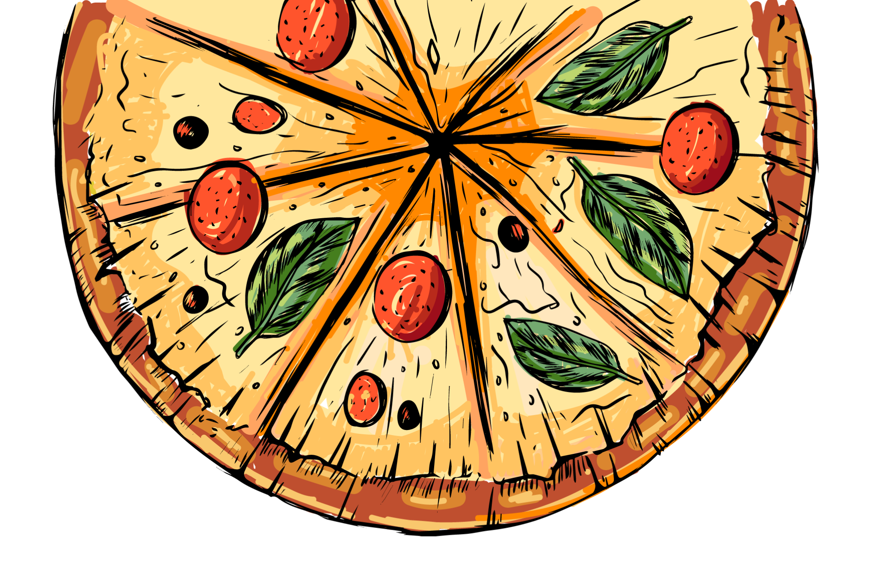
PIZZA SALES
www.slidesgo.es
ANALYSIS
BY MOHD ASAD KHAN

Slide 2


OBJECTIVES
01
02
03
04
How many customers do we have each day? Are there any peak hours?
How many pizzas are typically in order? Do we have any bestsellers?
How much money did we make this year? Can we identify any seasonality in the sales?
Are there any pizzas we should take off the menu, or any promotions we could leverage?

Slide 3
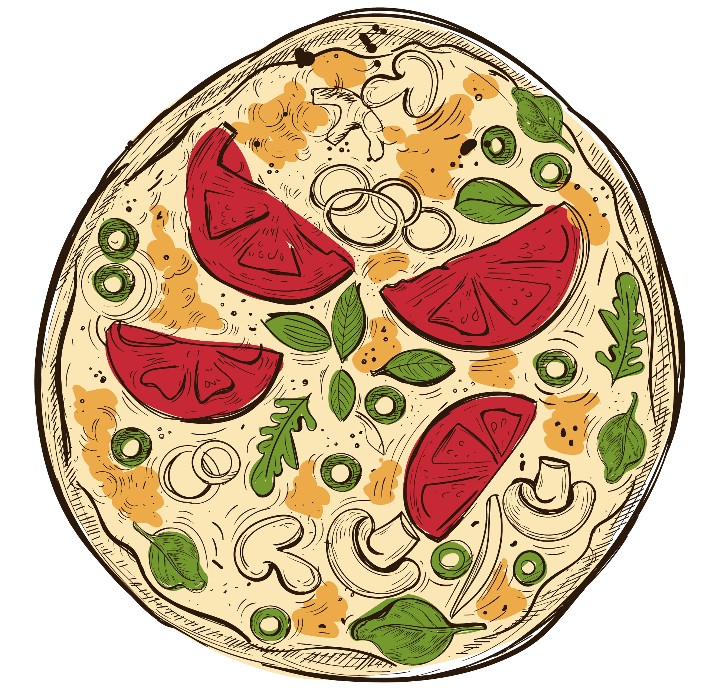


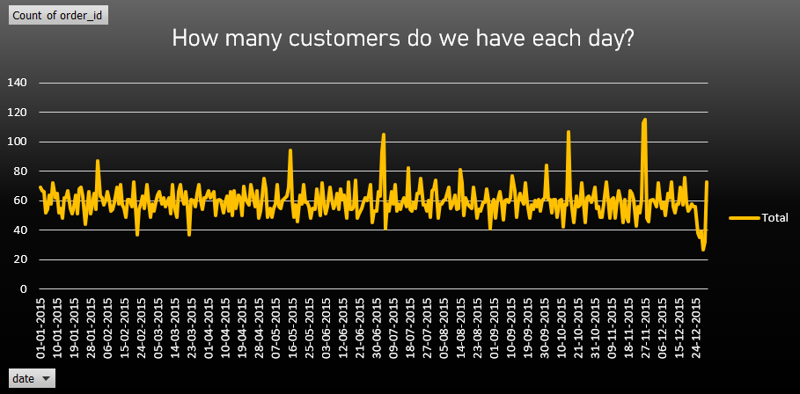
01

Slide 4
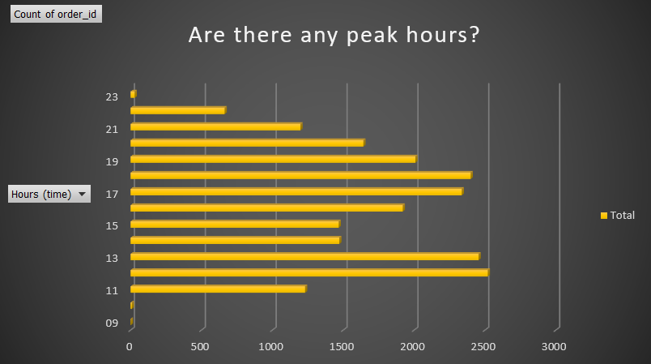
01
The peak hour at noon is 12:00 PM to 1:00 PM & evening 5:00 PM to 6:00 PM

Slide 5
02
How many pizzas are typically in order?
On average, it takes three pizzas to make an order

Slide 6
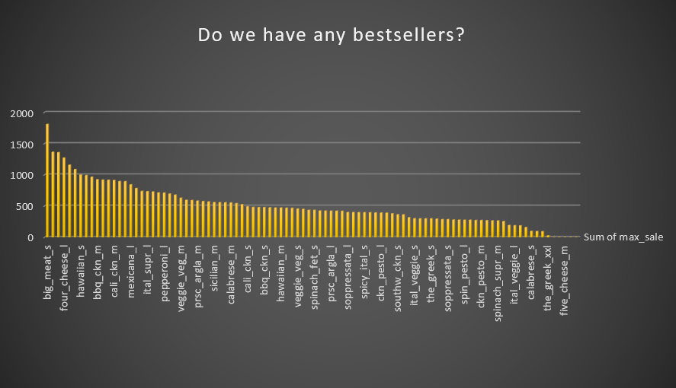
02
In 2015, big_meet_s ranked as the best seller.

Slide 7

$ 801944.7
03
How much money did we make this year?
was the total revenue generated in 2015

Slide 8
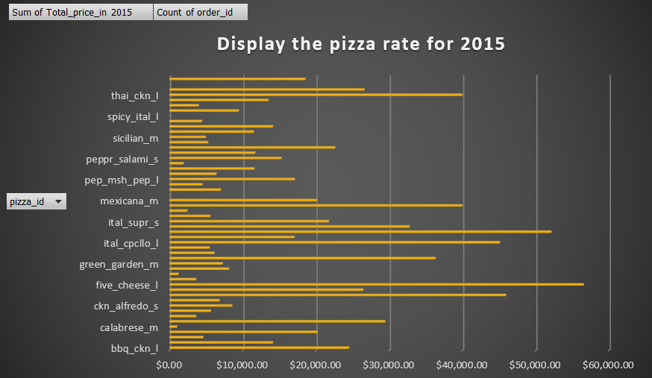

03
How much money did we make this year?

Slide 9
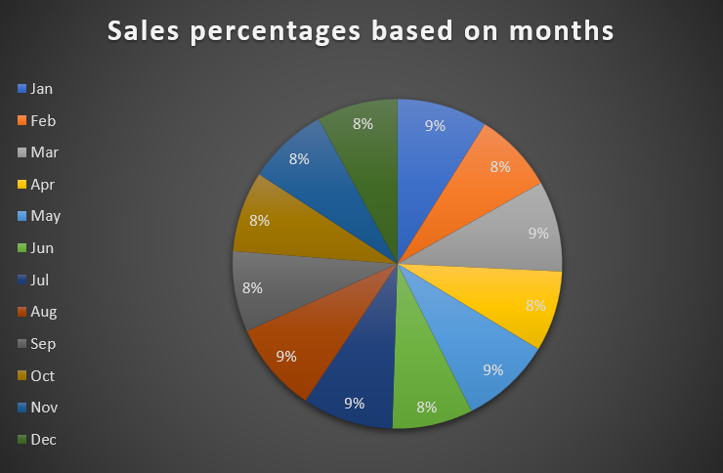
03
Can we identify any seasonality in the sales?
We have seasonality sales in July and May, which are 9.06% and 8.67% respectively.

Slide 10
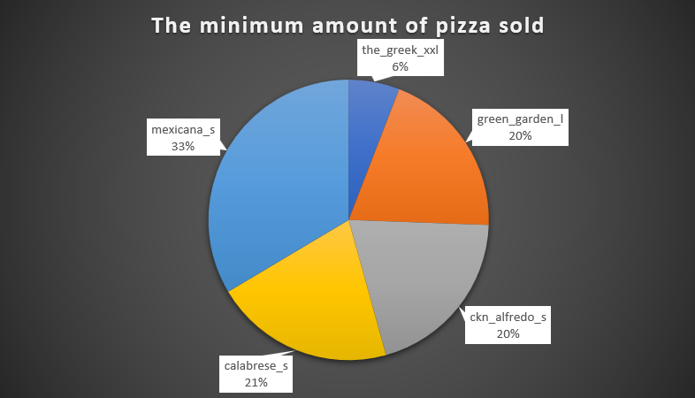
04
We should take off the_Greek_xxl pizza.

Slide 11
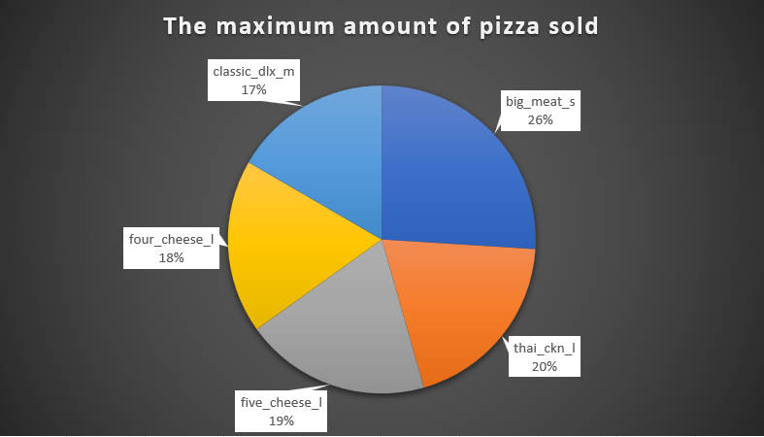
04
Take advantage of the pizza promotion at big_meet_s

Slide 12
THANK YOU

